Slide 1
Phonetics
Ms. S. Lavanya
Assistant Professor of English

Slide 8
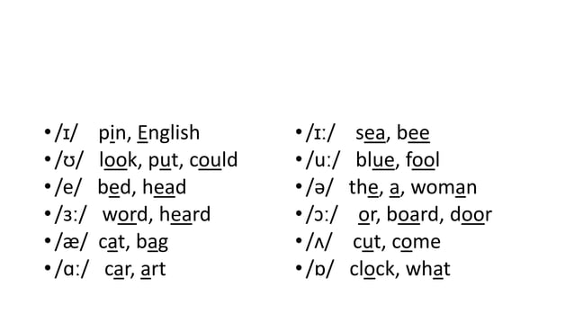
VOWELS WITH EXAMPLES

Slide 10
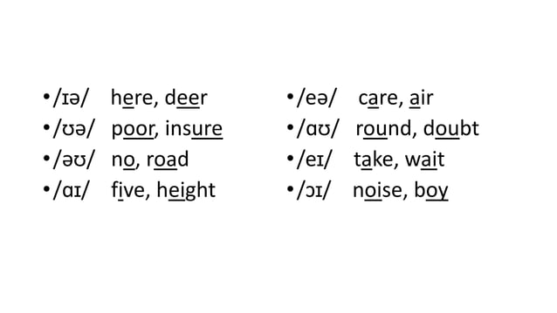
DIPTHONGS WITH EXAMPLES

Slide 13
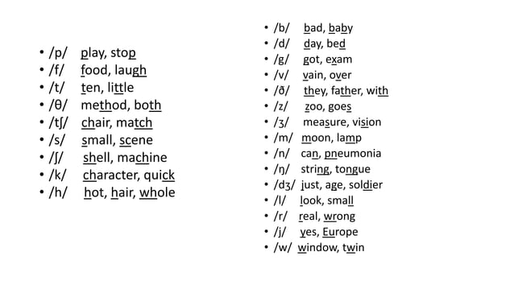
CONSONANTS WITH EXAMPLES

